Slide 1
SMART FARMING
Meghna Lohani 16BCE1395
Aman Sharma 16BCE1224
Kothuri Sai Phanindra 16BCE1075

Slide 2
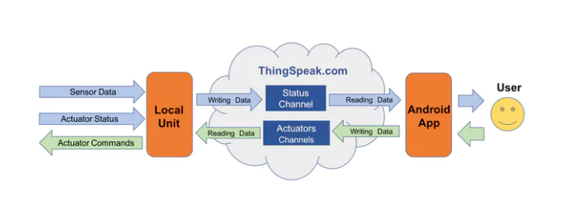
Logical Design

Slide 3
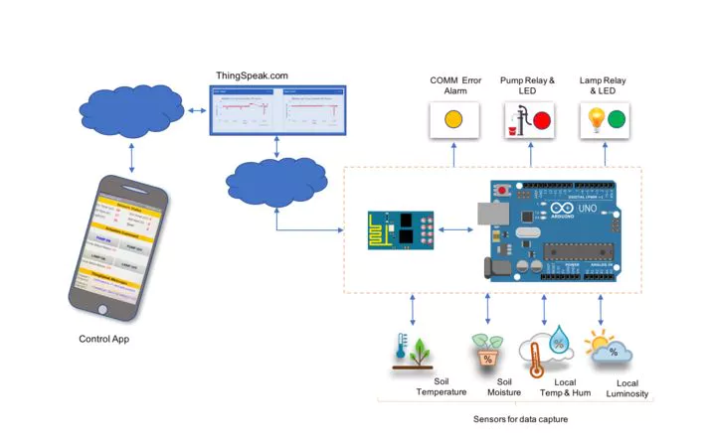
Physical Design

Slide 4
IOT Level 5
Several nodes
Actuators and sensors separately (Observers)
1 coordinator (Gateway) –WSN-based
Complex data analysis: different sensors
Cloud analysis
Reports collected
measurements and state/status to the cloud
Cloud storage

Slide 5
Abstract
Our goal will be to basically collect information from a local unit and send it to the internet. A user anywhere on the planet looking at this information will make decisions by sending remote commands to the actuators, which will also be in this local unit. Actuators can also turn on/off automatically based on the sensor data.
The data to be collected by sensors will be:
Air Temperature and relative humidity
Soil Temperature and humidity
Luminosity

Slide 6
The project will have 2 actuators:
Electrical Pump
Electrical Lamp
The status of those actuators ("ON/OFF"), should be also sent to the cloud.
So, the idea will be to capture those data from the sensors, for example, a plantation and send them to cloud. Based on those data, the actuator will take the decision based on those statements:
Turn ON the Pump if the soil humidity is too low
Turn ON the Lamp if the soil temperature is too low.

Slide 7
Communication API : ThingSpeak
ThingSpeak is an IoT analytics platform service that allows you to aggregate, visualize and analyze live data streams in the cloud. ThingSpeak provides instant visualizations of data posted by your devices to ThingSpeak. With the ability to execute MATLAB code in ThingSpeak you can perform online analysis and processing of the data as it comes in. ThingSpeak is often used for prototyping and proof of concept IoT systems that require analytics.

Slide 8
Components Needed
1 x 2 Channel DC 5V Relay Module with Optocoupler Low Level Trigger -
5V DC Pump -
220V Lamp
2 x 330 ohm resistor (to be used with LEDs)
2 x 10K ohm resistor (to be used with DHT22 and LDR)
1 x 4K7 ohm resistor (to be used with DS18B20
Protoboard
Jumpers
External 5V DC Power for Relays
Arduino UNO (Microcontroller)
ESP8266-01 (Communication Module) -
DHT22 (Air and Relative Humidity Sensor) -
DS18B20 (1-Wire Digital Temperature sensor for use on soil)
YL-69 + LM393 (Soil Humidity sensor) -
LDR (Luminosity Sensor) -
2 x LEDs (Red and Green)

Slide 9
Workflow
Installing sensors and ESP-01
Configuring ThingSpeak channel
Sending status to the cloud using status channels.
Basic app for data monitoring.
Installing actuators.
Configuring ThingSpeak actuator channel.
Sending command to actuators based on conditions.
Completing the app.

Slide 10
Cost
Rs. 2500 approx

Slide 11
DHT11 (Temperature and Humidity Sensor)
Temperature Range 0 ~ 50 C
Temp. Accuracy +/- 1C
Humidity Range 20 ~ 90%
Humidity Accuracy +/- 4%
The DHT11 measures relative humidity. Relative humidity is the amount of water vapor in air vs. the saturation point of water vapor in air.

Slide 12
Soil Moisture Sensor
Soil moisture content may be determined via its effect on dielectric constant by measuring the capacitance between two electrodes implanted in the soil. Where soil moisture is predominantly in the form of free water. The dielectric constant is directly proportional to the moisture content. The probe is normally given a frequency excitation to permit measurement of the dielectric constant.

Slide 13
DS18B20 Digital Temperature Sensor (Soil temperature)
Can be powered from data line. Power supply range is 3.0V to 5.5V Zero standby power required Measures temperatures from -55°C to +125°C. Fahrenheit equivalent is -67°F to +257°F ±0.5°C accuracy from -10°C to +85°C

Slide 14
LDR
Max power dissipation
200mW
Max voltage
200V
Peak wavelength
600nm
Min. resistance
1.8kΩ

Slide 15
Protocols Used At each layer
Application Layer - MQTT
Transport layer - TCP/IP
Network layer - IPv4

Slide 16
Connecting Sensors

Slide 17
Connecting to Cloud(ThingSpeak.com)

Slide 18
Actuators

Slide 19
Final Output

Slide 20
Difficulties faced in making this project
Configuring ESP8266
Sending data to ThingSpeak.com

Slide 21
What we learned?
Interfacing sensors with Arduino
Using ThingSpeak platform
Controlling the Actuators

Slide 22
Thank You!

